Slide 1




FursadLearn
By Run Hajir
01

Slide 2

Problem
Many students struggle to find schorlarship,bursaries and free learning opportunities.
Information is scattered across different websites and social media platform.
Student often miss opportunities because they don’t know where to find them and when to apply.
10

Slide 3


Solution
One Platform: FursadLearn brings scholarship, bursary, and free online course opportunities together in one place.
06

Slide 4
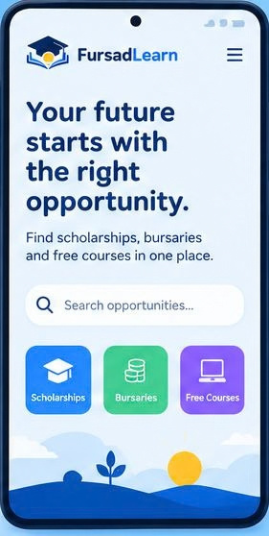
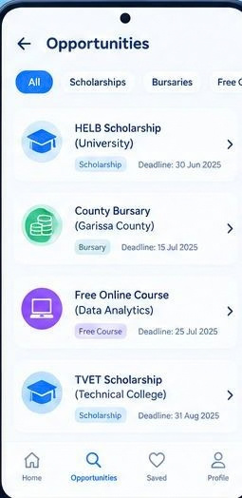
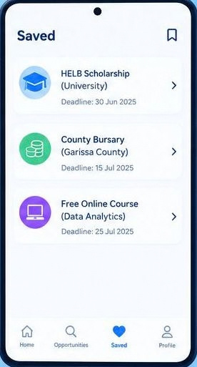
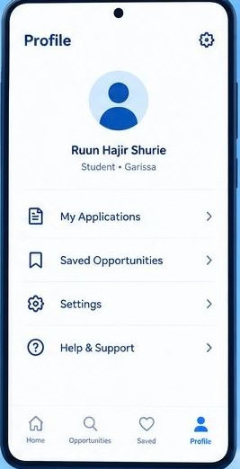
Product
Home
Opportunities
Saved
Profile
04

Slide 5



Target Market
4 OUT 5
Students struggle to find reliable information about scholarships, bursaries and free learning opportunity.
75%
Students may miss educational opportunities because information is scattered across different platforms.
60%
Young people need easier access to schalarships, financial support, and free digital skills courses.
14

Slide 6
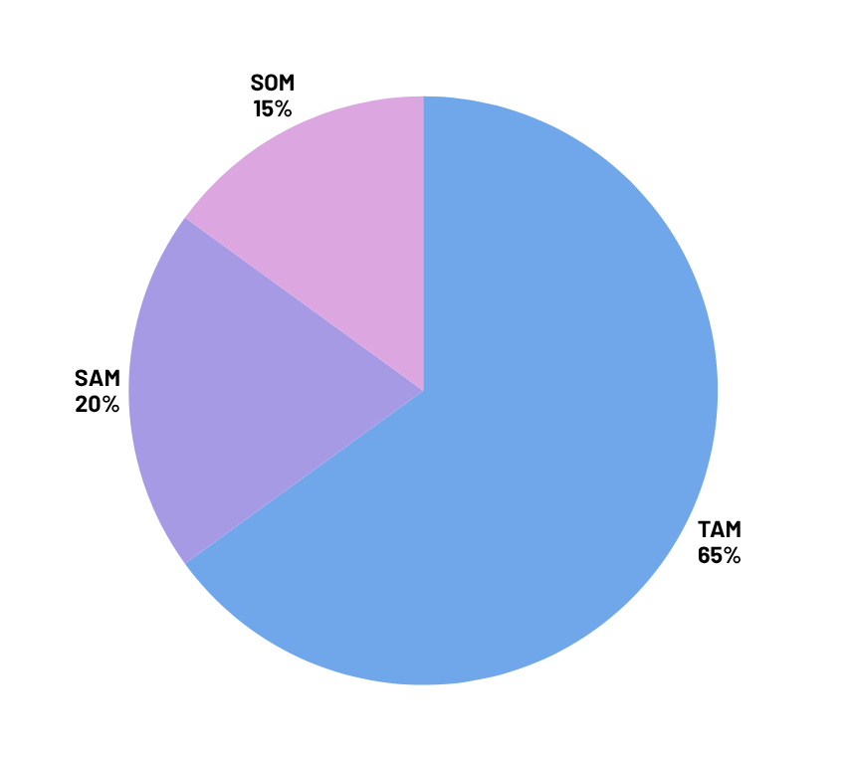
Market Size
  The Total Addressable Market(TAM): Their are approximately 5 millions students in Kenya.
  The Serviceable Addressable Market(SAM): The are 3.7 million students who have missed schalarship opportunities.
  The Serviceable Obtainable Market(SOM): The are 300 000 students who are actively looking for scholarship and learning opportunities.

Slide 7
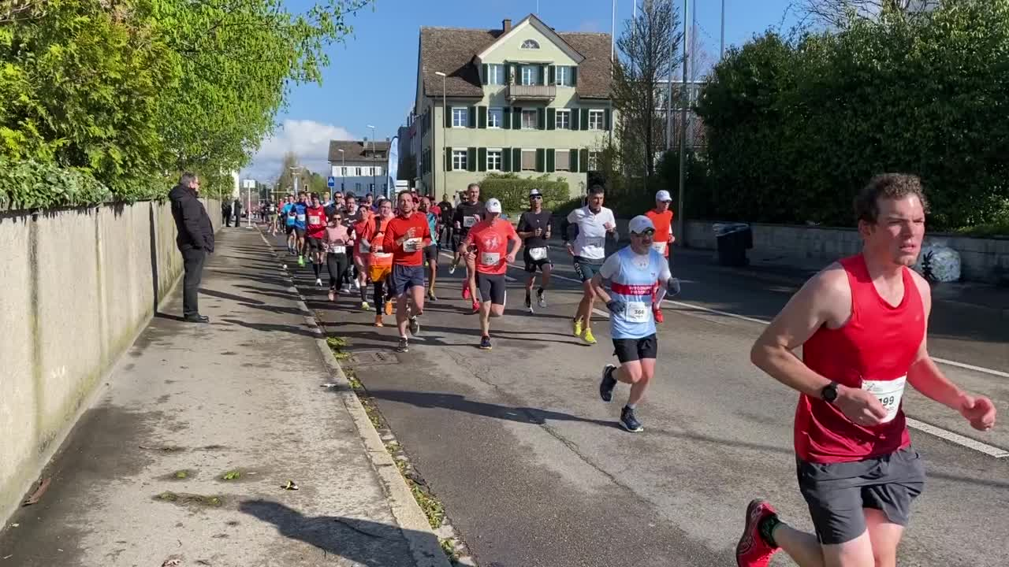

Competitors
Ajira scholars
They offer scholarship opportunities
23

Slide 8

Competitive Advantage
We focus on students in North Eastern Kenya, where access to learning opportunities can be limited.
We aim to make learning resources accessible to students with limited internet connectivity.
Students can find courses, scholarships, mentorship, and career opportunities on one platform.

Slide 9
Project Traction
Agu
week 3-4
Sep
week 1-4
Oct
week 1-4
Nov
week 2-4
Dec
week 1-4
Tasks
Conduct market research
Define product feature
Create prototypes
Begin development
Conduct Integration testing
Launch the MVP
Monitor and analyze user engagement
23

Slide 10

Subscription-Based Model
Basic Plan: Free
Student Plan: $2.50/month
Institutional Plan: $75/month
Targeted Annual Revenue
800 students × $2.50 × 12 = $24,000
15 institutions × $75 × 12 = $13,500
Total Revenue: $37,500
Estimated Profit: $37,500 − $12,000 costs = $25,500
Profit Margin: ($25,500 ÷ $37,500) × 100 = 68%
Business Model
23

Slide 11
Go To Market
Start locally
Use affordable communication channels
Build partnerships
Grow through referrals

Slide 12
Social Impact
SDG 4: Quality Education
SDG 8: Decent Work and Economic Growth
SDG 10: Reduced Inequalitie

Slide 13
Our Ask
Mentorship from software developers and startup experts.
Technical support to design and build the first prototype.
Partnerships with schools, colleges, NGOs, and training providers.
Pilot users who can test the platform and give honest feedback.
Resources or funding to support development and initial testing.

Slide 14
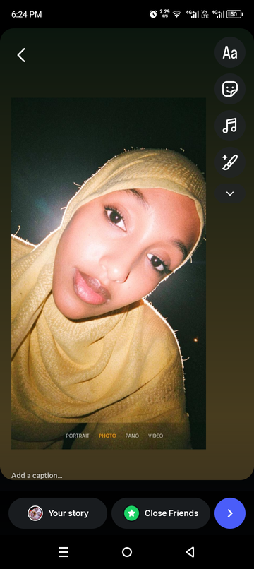
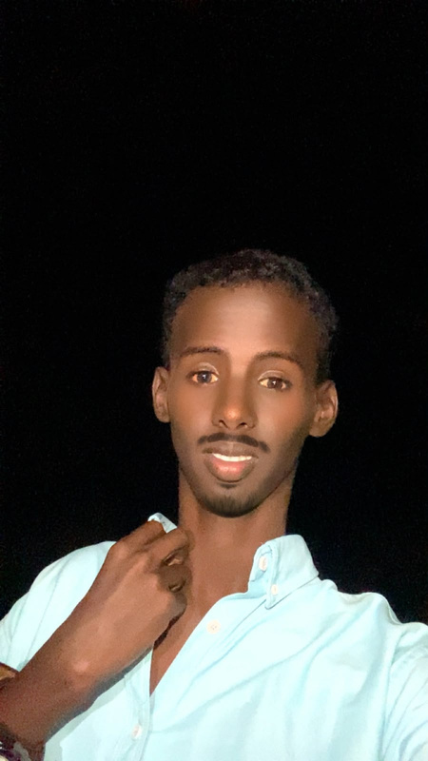
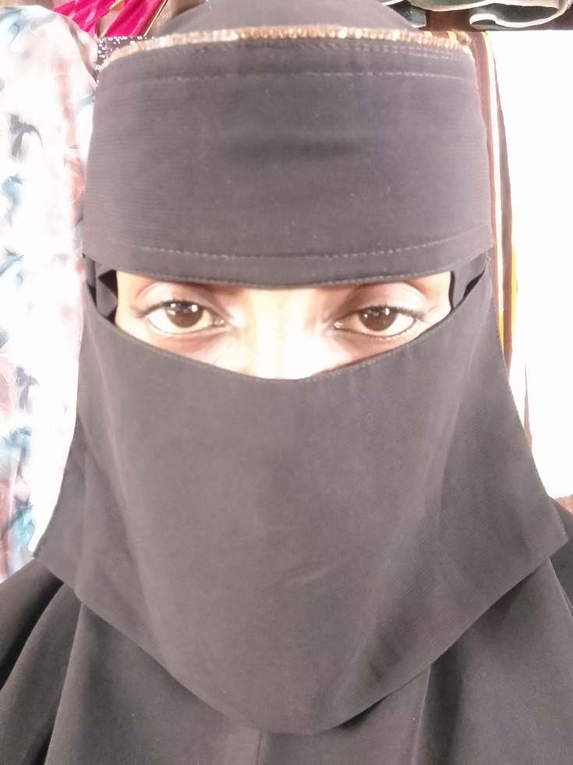
Team Members
RUN HAJIR
ABDI FATAH
NEEMA ABEY
Founder
Co-founder
Technical Lead

Slide 15




Thank you!
Email: runhshurie@gmail.com
Tiktok: FursadLearn
17

